Slide 1

Tag 2
More on HTML Tags

Slide 2
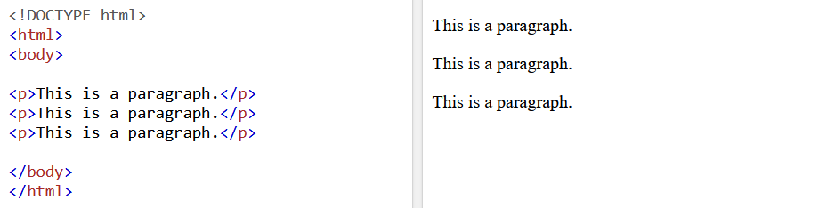
HTML PARAGRAPHS
Tag <p> defines a paragraph.
It always starts a new line, and browser automatically add some white space (margin) before and after a paragraph.

Slide 3
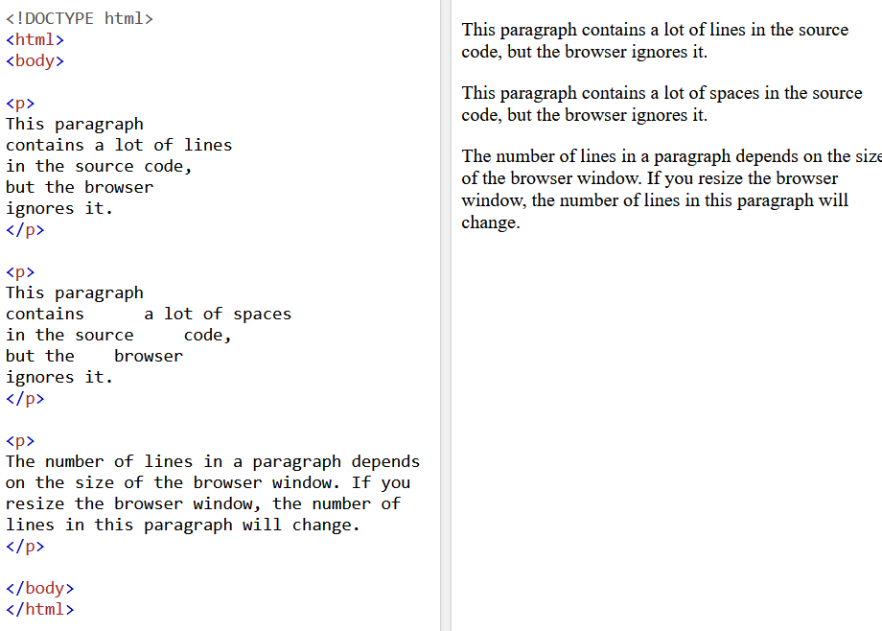
BEWARE!
Browser will automatically remove any extra spaces and lines when displayed.

Slide 4
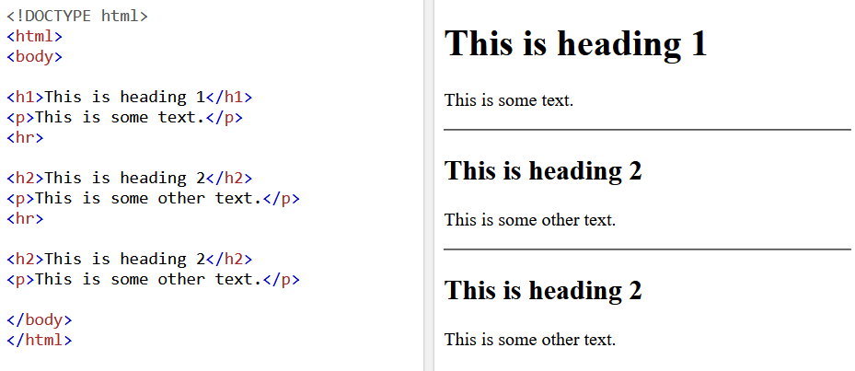
HTML HORIZONTAL RULE
The <hr> tag defines a thematic break in HTML pages.
It is mainly used to separate contents in a HTML page.

Slide 5
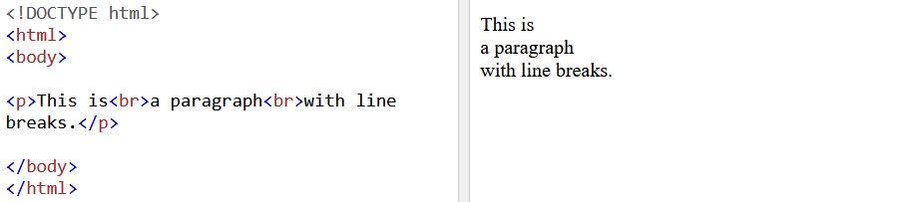
HTML LINE BREAKS
HTML <br> element defines a line break.

Slide 6
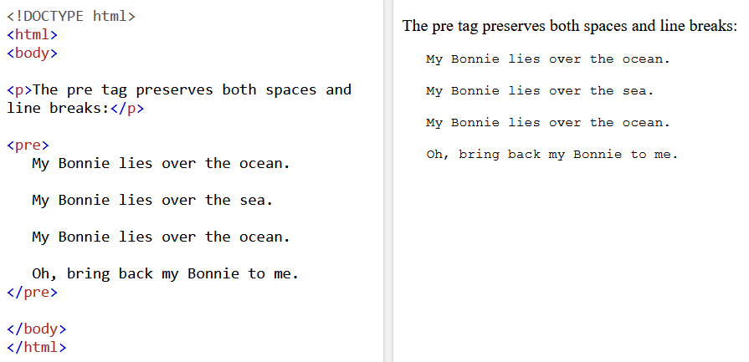
HTML PRE-FORMAT ELEMENT
<pre> element defines a preformatted text.
It preserves both spaces and line breaks.

Slide 7
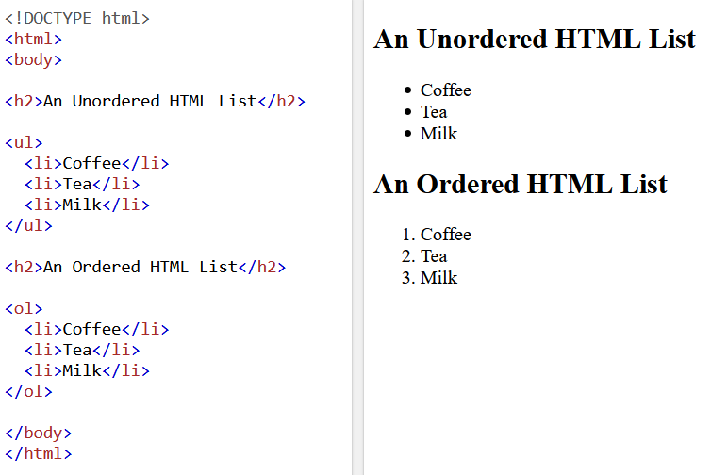
HTML LIST ELEMENT
Allows developers to group a set of related items together in a list.
There are 2 types of lists, namely ordered and unorded.

Slide 8
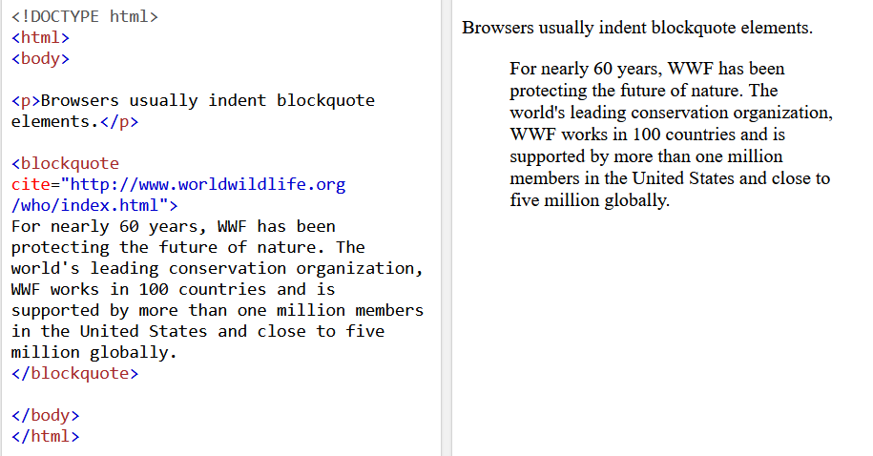
HTML <blockquote>
Defines a section that is quoted from another source.
Usually displayed indented.

Slide 9
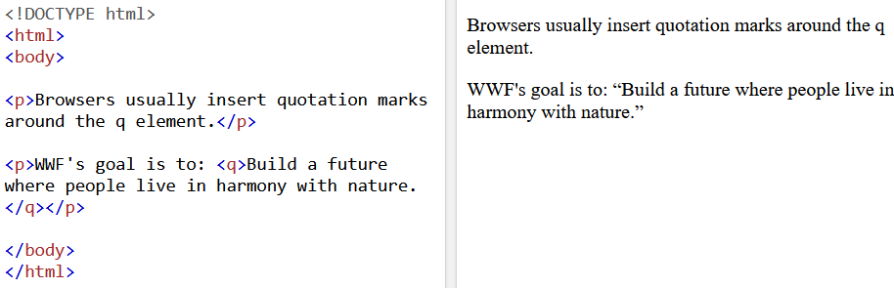
HTML <q>
Defines a short quotation
Usually displays the quotation marks.

Slide 10
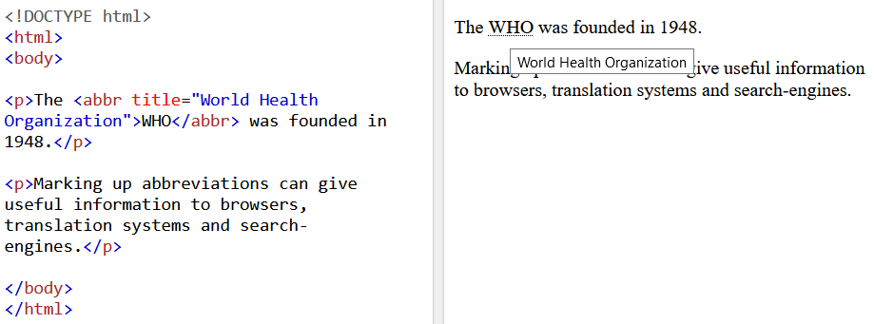
HTML <abbr>
Defines an abbreviation or an acronym.
It can give useful information to browsers, translation systems and search engines.

Slide 11
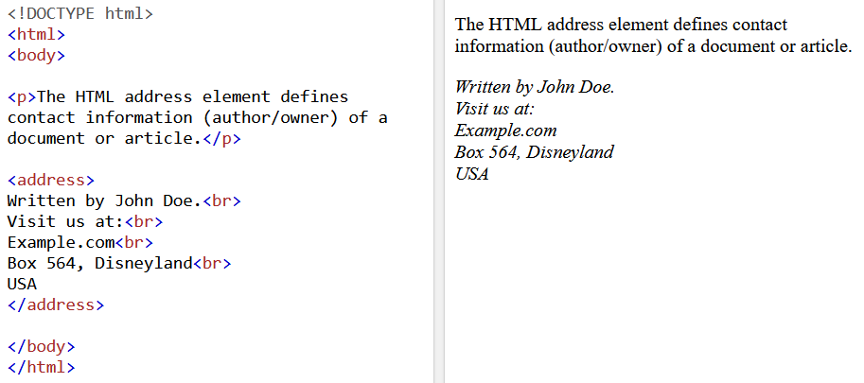
HTML <address>
Defines the contact information of the author/owner of the document or article.
It can contain addresses such as email, phone number, etc.
Usually displayed in italics.

Slide 12
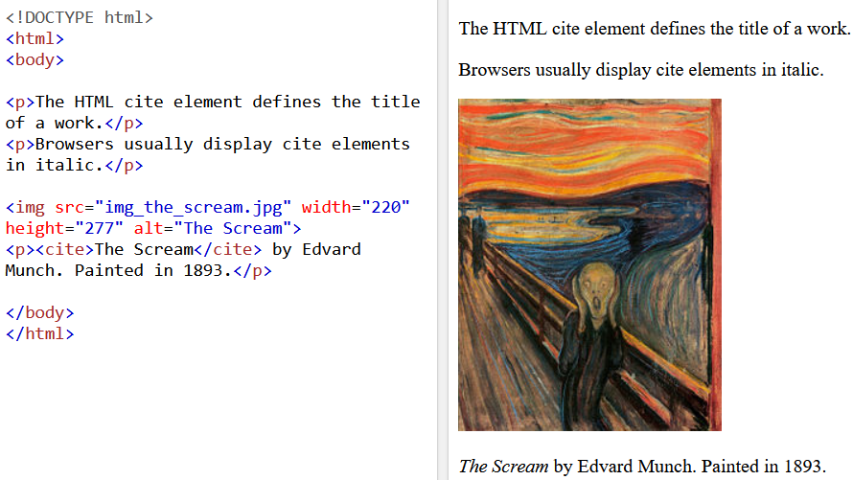
HTML <cite>
Defines the title of the creative work
Usually displayed in italics.

Slide 13
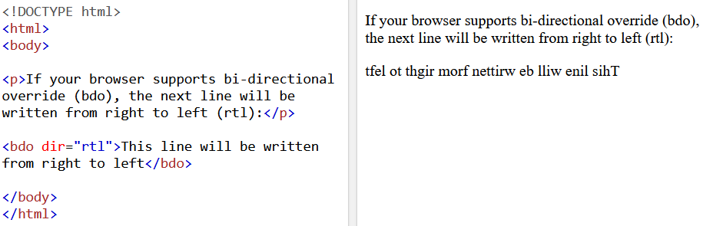
HTML <bdo>
BDO stands for bi-directional Override.
It is used to override current text direction.
Example reads “right-to-left”

Slide 14
Task 3
Using all of the things that we’ve learnt so far, create me a page that is titled ABOUT ME. List down 3 favourite food, in order of preference, in the body. Add in 3 images of your favourite food. At the end of the image, add in citation.
Then sign off at the footer of the document.

